Slide 1
P248-Customer Personality Analysis
Presented By Group 3:
Anitharani Y
Arigela Kumar Gowri Sankar Sairam
Hemant Kumar B K
Sanjay Kumar T
Swapna Elagandula
Mentor: Saurabh Singh

Slide 2
Contents:
Bussiness objective
Data Collection
Exploratory data analysis
Visualizations
Data preprocessing
Model building
Deployment

Slide 3
Business Objective:
Customer Personality Analysis is a detailed analysis of a company’s ideal customers. It helps a business to better understand its customers and makes it easier for them to modify products according to the specific needs, behaviors and concerns of different types of customers. Customer personality analysis helps a business to modify its product based on its target customers from different types of customer segments. For example, instead of spending money to market a new product to every customer in the company’s database, a company can analyze which customer segment is most likely to buy the product and then market the product only on that particular segment.

Slide 4
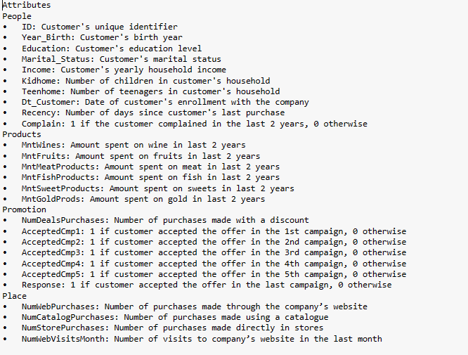
Attributes:

Slide 5
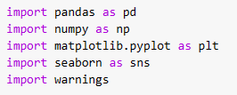
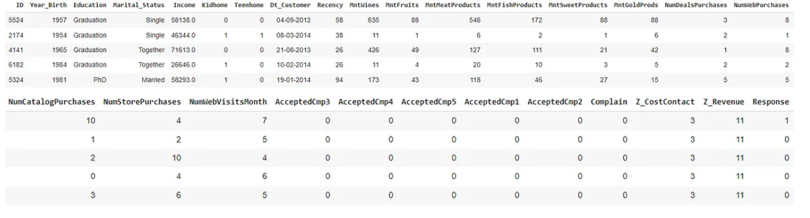
Data Collection:

Slide 6
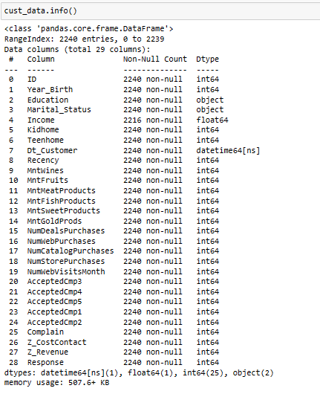
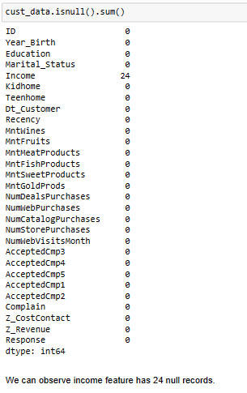
Exploratory data analysis (EDA):

Slide 7
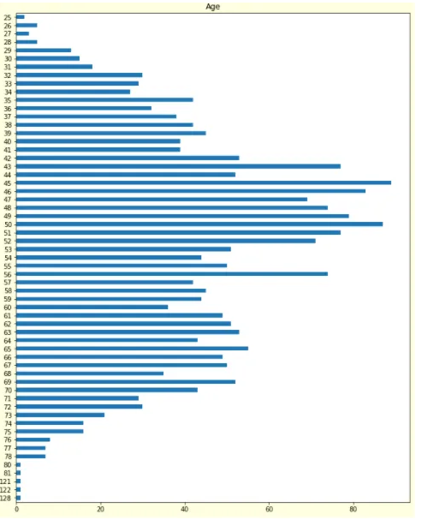
Visualizations:
We can observe in above plot customers age between 27 to 80 and vey few customers are above 120 age.

Slide 8
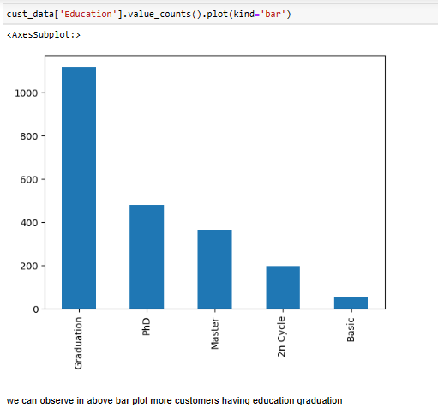
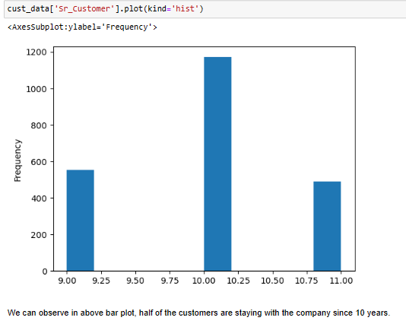

Slide 9
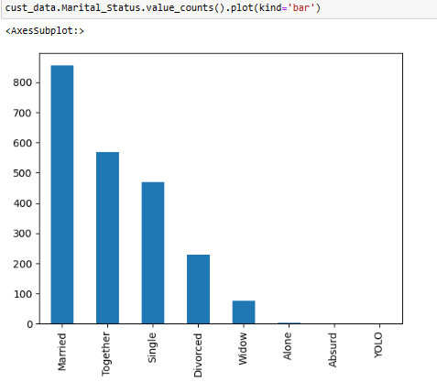
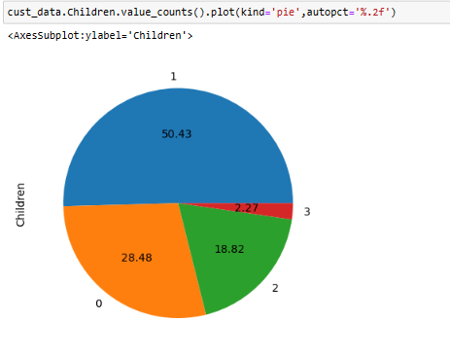
We can see in above bar plot, more customers are married , together status and single, divorced and widow are less in number. alone, absurd, yolo status customers are very minute. so we can categorize this data into either married or single.
We can observe in above plot, more than half customers have atleast one children and least percentage of customers having 3 children.

Slide 10
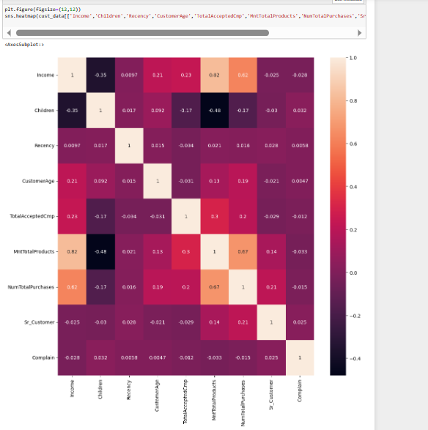
We can observe Income feature is having strong correlation with amount spent on Totalproducts and number of Total purchases. and children have negative correlation with amount spent on Total Products

Slide 11
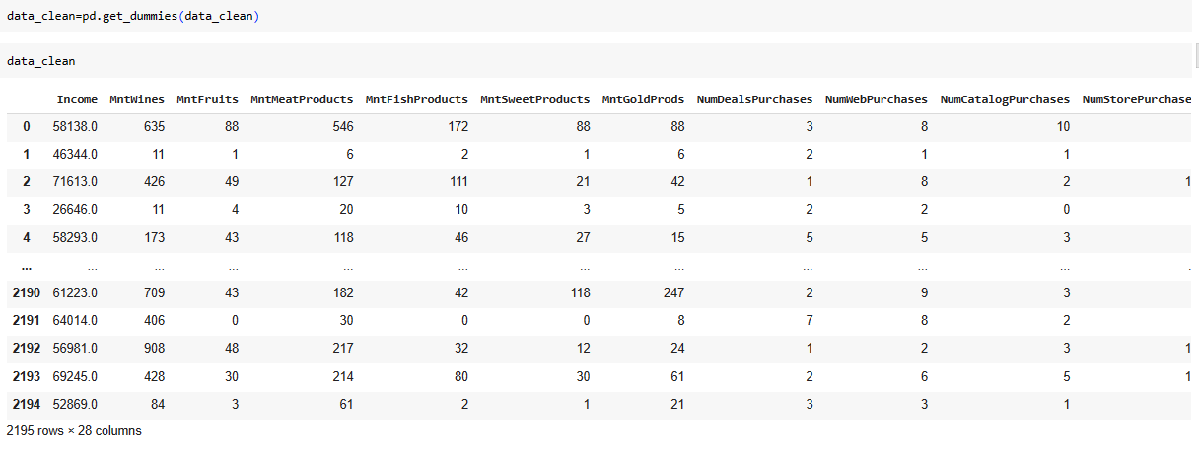
Data Preprocessing:
For category column ,we do one-hot encoding because all the categories column have ordinal data.

Slide 12
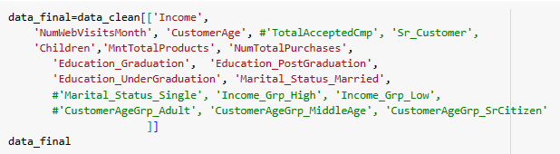
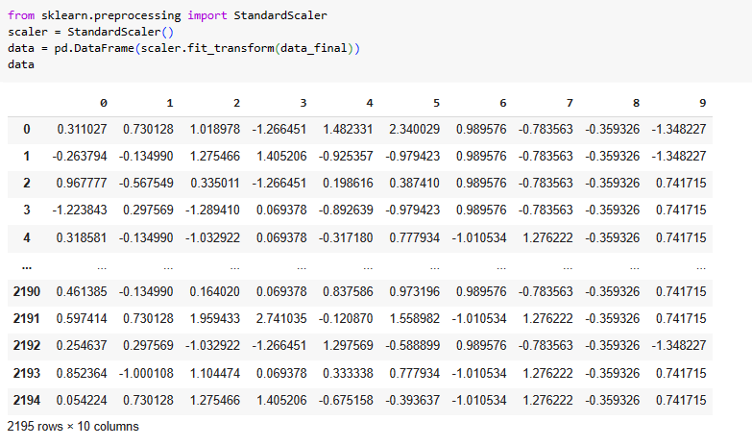

Slide 13
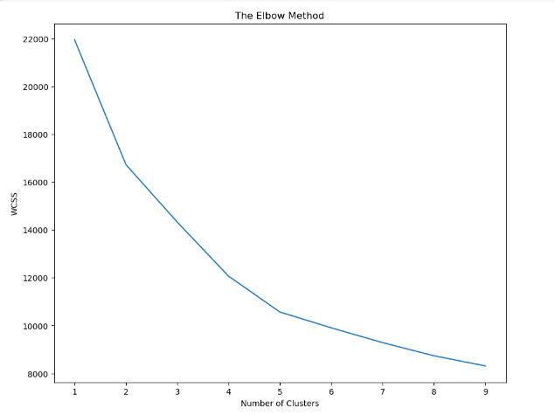
Clustering:
K -Mean Clustring
For picture beside , we can see when n_cluster = 5 the inertia score did’nt change significantly , so we will use n_cluster = 5

Slide 14
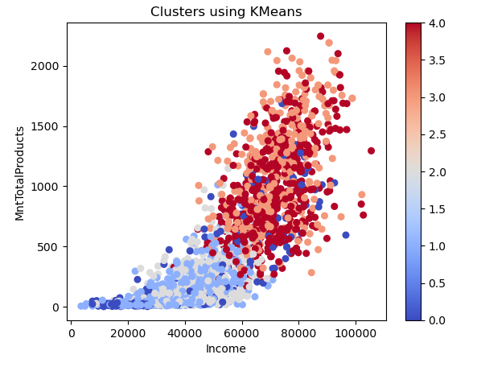
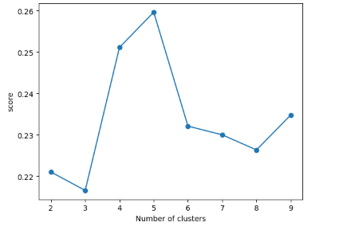
Silhouette score
For picture above , we can see when n_cluster = 5, it get 0.259677 at silhouette score

Slide 15
Project Overview:
Performed an unsupervised clustering of data on the customer's records froma groceries firm's database.
Calculated the optimal number of clusters using elbow curve and silhouettescore.
Built a K-means model using optimal number of clusters and evaluated the model and analyzed the clusters formed.
Summarized the clusters by profiling customers according to their family structures and income/spending. This can be used in planning bettermarketing strategies

Slide 16
Model Deployment Using Streamlit:
https://sairamarigela-clustering-cutomeranalysis-cs-app-hpzkkh.streamlit.app/

